Slide 1
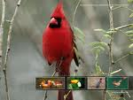
Brown Bear, what did he see?
Yellow Duck?
Red Bird?

Slide 2
Brown Bear, what did he see?
Yellow Duck?

Slide 3
Brown Bear, what did he see?
Red Bird!

Slide 4
What did red bird see?
Yellow Duck?
Blue Horse?

Slide 5
What did red bird see?
Blue Horse?

Slide 6
What did red bird see?
Yellow Duck?

Slide 8
Brown Bear, what did he see?
Yellow Duck?

